Slide 1
7 Memory and Programmable Logic
26年 11月 8日
ASIC LAB.

Slide 2
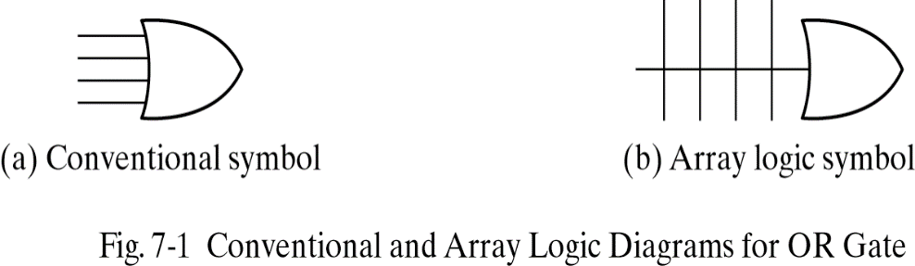
7.1 INTRODUCTION
Memory
RAM(random access memory): read and write operation
ROM(read only memory) : only read operation
Programmable Logic Device
PLD(programmable logic device)
PLA(programmable logic array)
PAL(programmable array logic)
FPGA(field programmable gate array)
26年 11月 8日

Slide 3
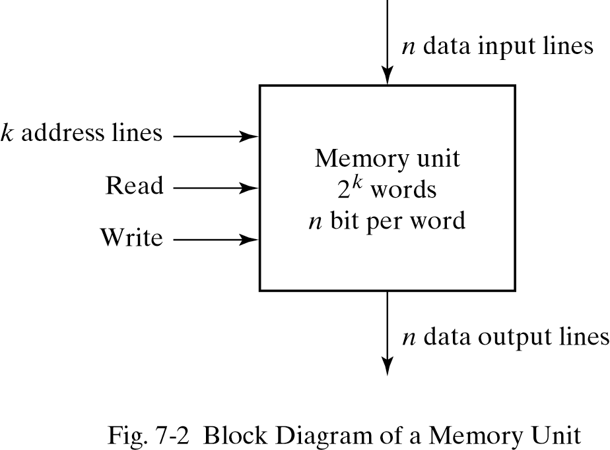
7.2 RANDOM-ACCESS MEMORY
The address lines select one particular word.
A decoder inside the memory accepts this address and opens the paths needed to select the word specified.
26年 11月 8日

Slide 4
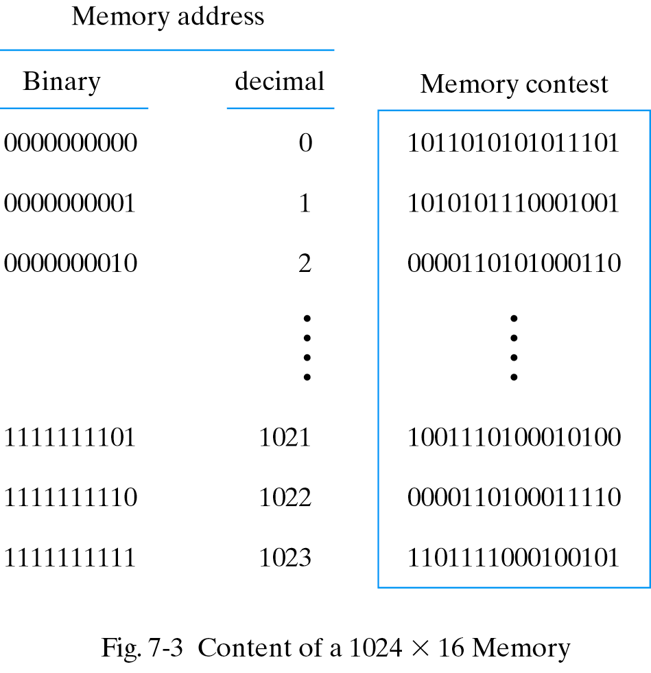
1024x16 Memory
The 1K * 16 memory has 10 bits in the address and 16 bits in each word.
26年 11月 8日

Slide 5
Write and Read Operations
Write operation
1.Transfer the binary address of the desired word to the address lines.
2.Transfer the data bits that must be stored in memory to the data input lines.
3.Activate the write input
Read operation
1.Transfer the binary address of the desired word to the address lines.
2.Activate the read input.
26年 11月 8日

Slide 6
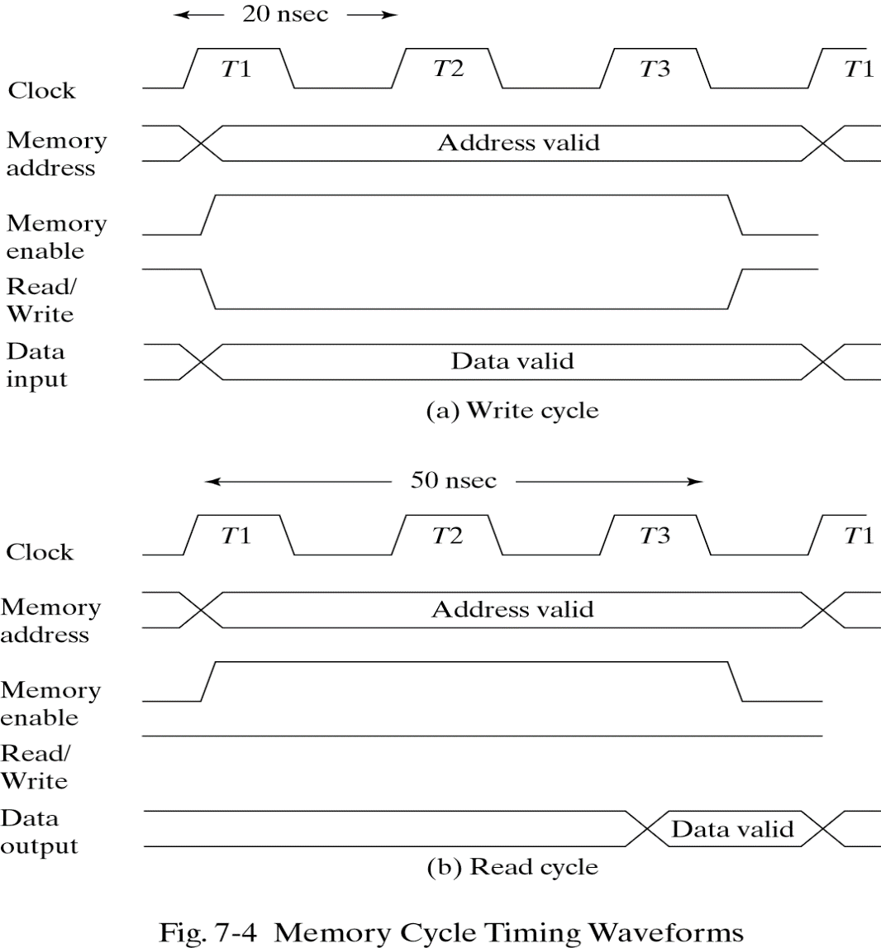
Timing Waveforms
2022-11-29
*

Slide 7
Types of Memories
Random access Memory -each word occupy one particular location.the access time is always the same
Sequential access Memory-information is read out only when the required word has been reached. the access time is variable.
Volatile -Memory units lose the stored information when power is turned off.
Nonvolatile-A nonvolatile memory retains its stored information after removal of power. ex) magnetic disk ,ROM(Read Only Memory)
Static RAM-The stored information remains valid as long as power is applied to the unit. Static RAM is easier to use and has shorter read and write cycles.
Dynamic RAM-The capacitors must be periodically recharged by refreshing the dynamic memory. Dynamic RAM offers reduced power consumption and larger storage capacity
26年 11月 8日

Slide 8
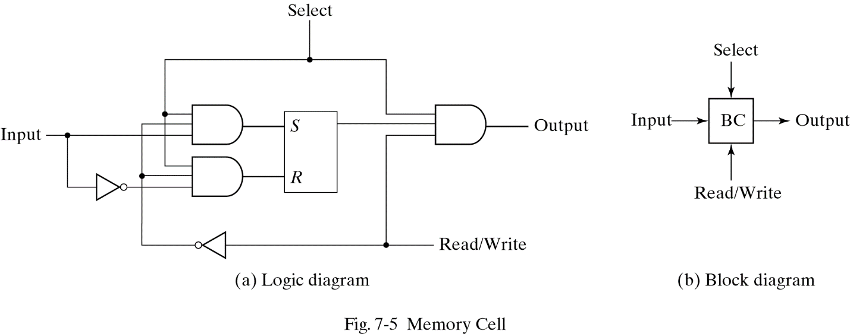
7.3 MEMORY DECODING
The equivalent logic of a binary cell that stores one bit of information
The binary cell stores one bit in its internal flip-flop
It has three inputs and one output. The read/write input determines the cell operation when it is selected.
26年 11月 8日

Slide 9
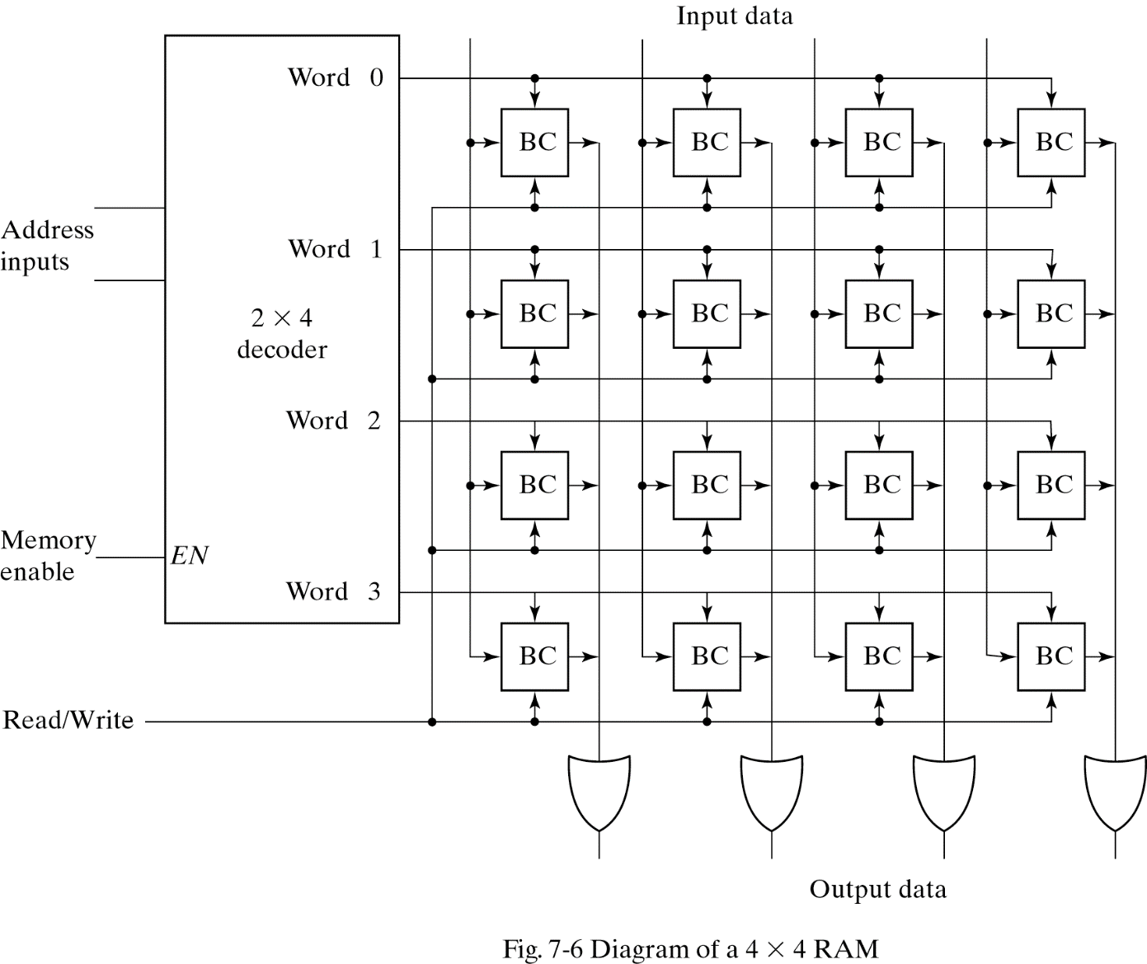
Internal Construction
26年 11月 8日

Slide 10
Internal Construction
It has 16 binary cells
Memory enable=0; all outputs of the decoder =0 , none of the memory words are selected.
Memory enable=1; one of the four words is selected. The read/write input determines the operation.
During the read operation, the four bits of the selected word go through OR gates to the output terminals.
During the write operation, the data available in the input lines are transferred into the four binary cells of the selected word.
26年 11月 8日

Slide 11
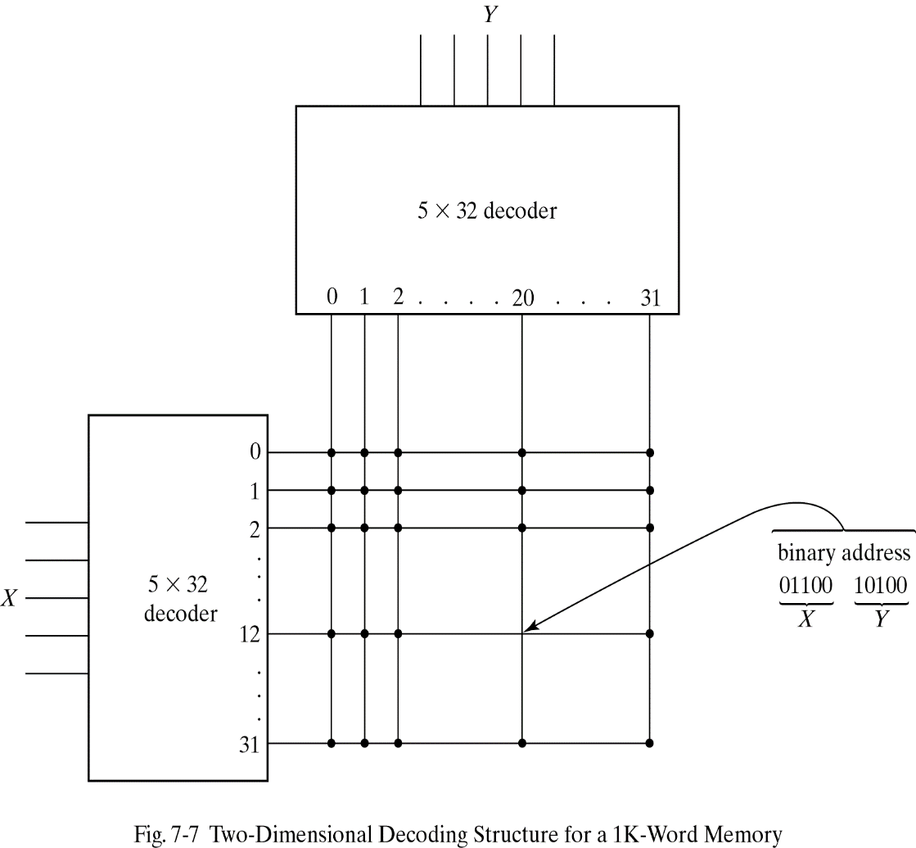
Coincident Decoding
The basic idea in two-dimensional decoding is to arrange the memory cells in an array that is close as possible as square. In this configuration, two k/2-input decoders are used instead of one k-input decoder.
In the two-decoder case,we need 64 AND gates with five inputs in each.
If the word address is 404, X=01100 (12) and Y=10100(20).
26年 11月 8日

Slide 12
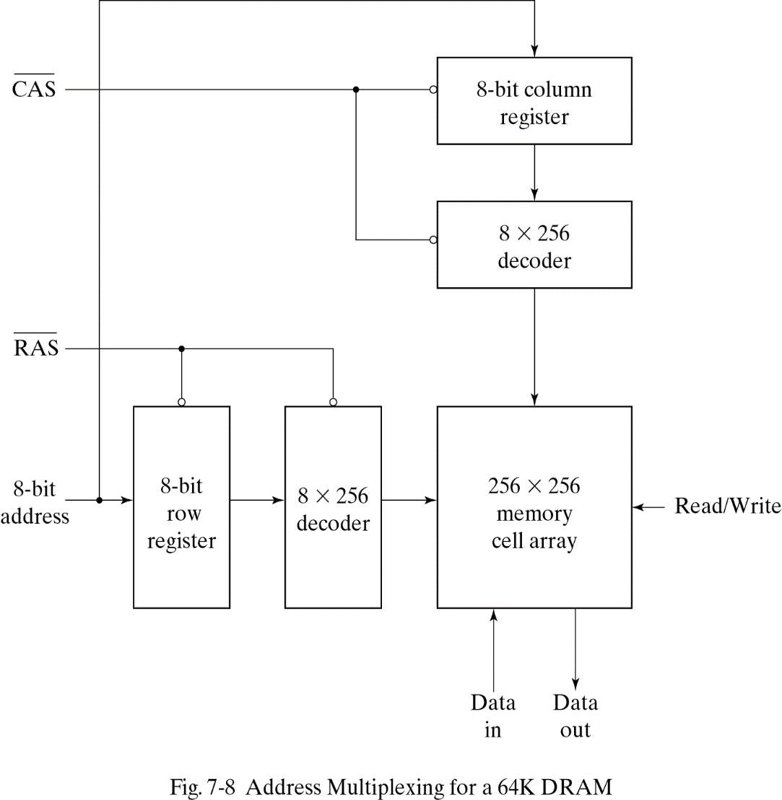
Address Multiplexing
To reduce the number of pins in the IC package, designers utilize address multiplexing whereby one set of address input pins accommodates the address components.
Since the same set of pins is used for both parts of the address, the size of the package is decreased significantly.
26年 11月 8日

Slide 13
7.4 ERROR DETECTION AND CORRECTION
8-bit data word =>11000100
Bit position 1 2 3 4 5 6 7 8 9 10 11 12
P1 P2 1 P4 1 0 0 P8 0 1 0 0
P1=XOR of bits(3,5,7,9,11)=0 (XOR performs the odd function.)
P2=XOR of bits(3,6,7,10,11)=0
P4=XOR of bits(5,6,7,12)=1
P8=XOR of bits(9,10,11,12)=1
In memory, Bit position 1 2 3 4 5 6 7 8 9 10 11 12
0 0 1 1 1 0 0 1 0 1 0 0
When the 12 bits are read from memory ,The four check bits
C1=XOR of bits (1,3,5,7,9,11) C2=XOR of bits (2,3,6,7,10,11)
C3=XOR of bits (4,5,6,7,12) C4=XOR of bits (8,9,10,11,12)
26年 11月 8日

Slide 14
Hamming code
Since the bits were stored with even parity C=C8C4C2C1=0000 (No error)
Bit position 1 2 3 4 5 6 7 8 9 10 11 12
0 0 1 1 1 0 0 1 0 1 0 0 No error
1 0 1 1 1 0 0 1 0 1 0 0 Error in bit 1
0 0 1 1 0 0 0 1 0 1 0 0 Error in bit 5
Check bits C8 C4 C2 C1
With error in bit 1 : 0 0 0 0
With error in bit 5: 0 1 0 1
The error can be corrected by complementing the corresponding bit.
26年 11月 8日

Slide 15
Single-Error Correction , Double-Error Detection
The Hamming code can detect and correct only a single error. Multiple errors are not detected.
To correct a single error and detect double errors ,we include the additional parity bit.
If C=0 and P=0 No error occurred
If C=1 and p=1 A single error occurred , which can be corrected
If C=1 and P=0 A double error occurred, which is detected but cannot be corrected
If C=0 and P=1 An error occurred in the P13 bit
26年 11月 8日

Slide 16
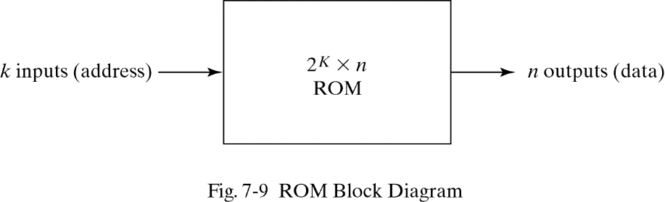
7.5 READ-ONLY MEMORY
ROM=Decoder + OR gates
-permanent binary information is stored.
k input lines and n output lines
The number of output lines ,n= the number of bits per word
26年 11月 8日

Slide 17
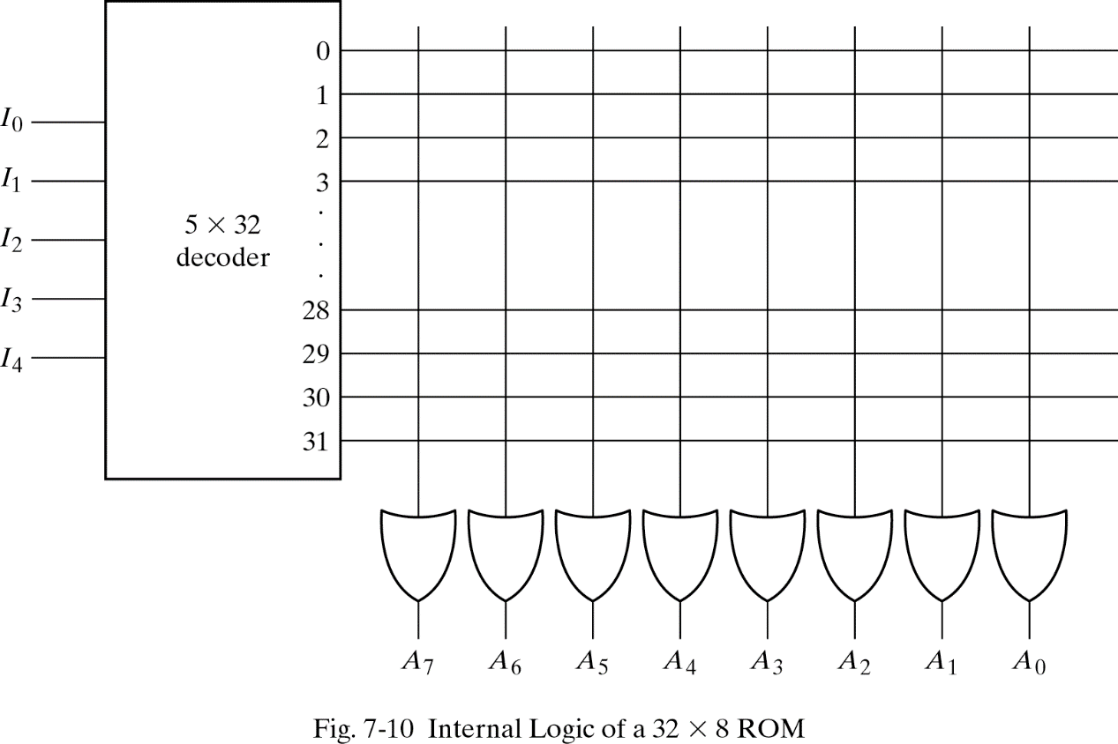
Read-Only Memory
ROM = AND gates connected as a decoder + a number of OR gates
5 X 32 decoder has 32 AND gates and 5 inverters.
32 words
26年 11月 8日

Slide 18
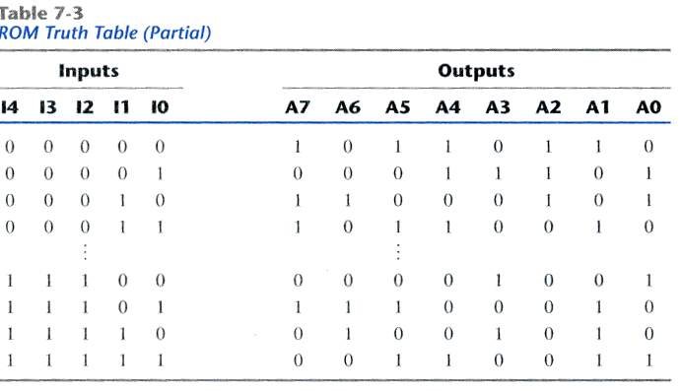
ROM Truth Table(Partial)
26年 11月 8日

Slide 19
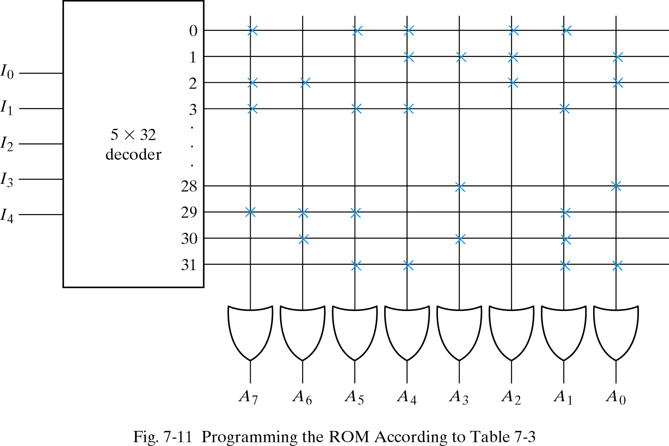
Combinational Circuit Implementation
‘1’
‘0’
A7(I4,I3,I2,I0)=Sum of minterms(0,2,3,…,29)
Input->00011(3)
Others-> all ’0’
Output->10110010
26年 11月 8日

Slide 20
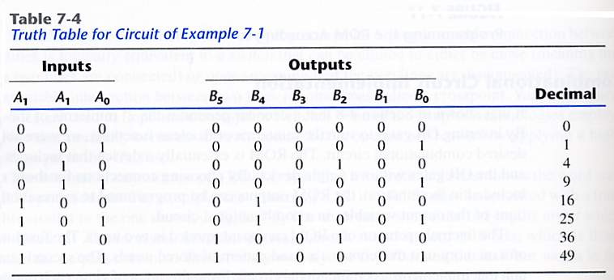
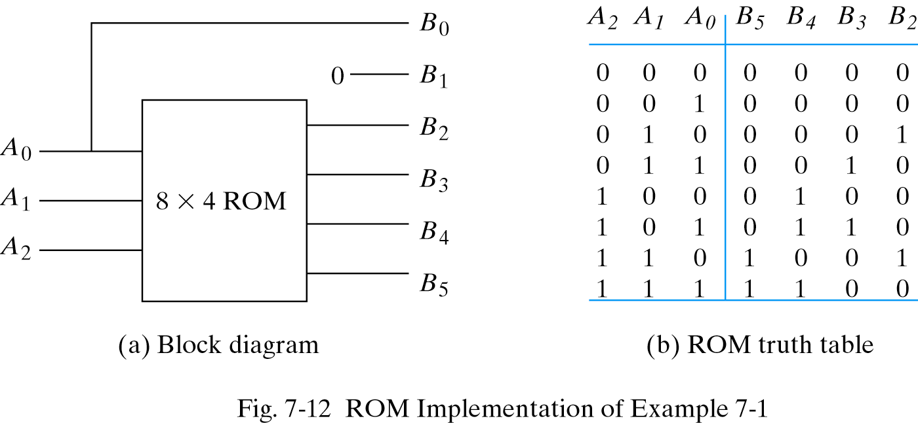
EXAMPLE 7-1
26年 11月 8日

Slide 21
Types of ROMs
For large quantities, mask programming is economical .
For small quantities , programmable read-only memory(PROM) is more economical.(all ‘1’s)
PROM- irreversible and permanent
EPROM(Erasable PROM)- can be restructured to the initial value(UV light->discharge)
EEPROM(Electrically erasable PROM)- can be erased with electrical signals instead ultra violet light.
26年 11月 8日

Slide 22
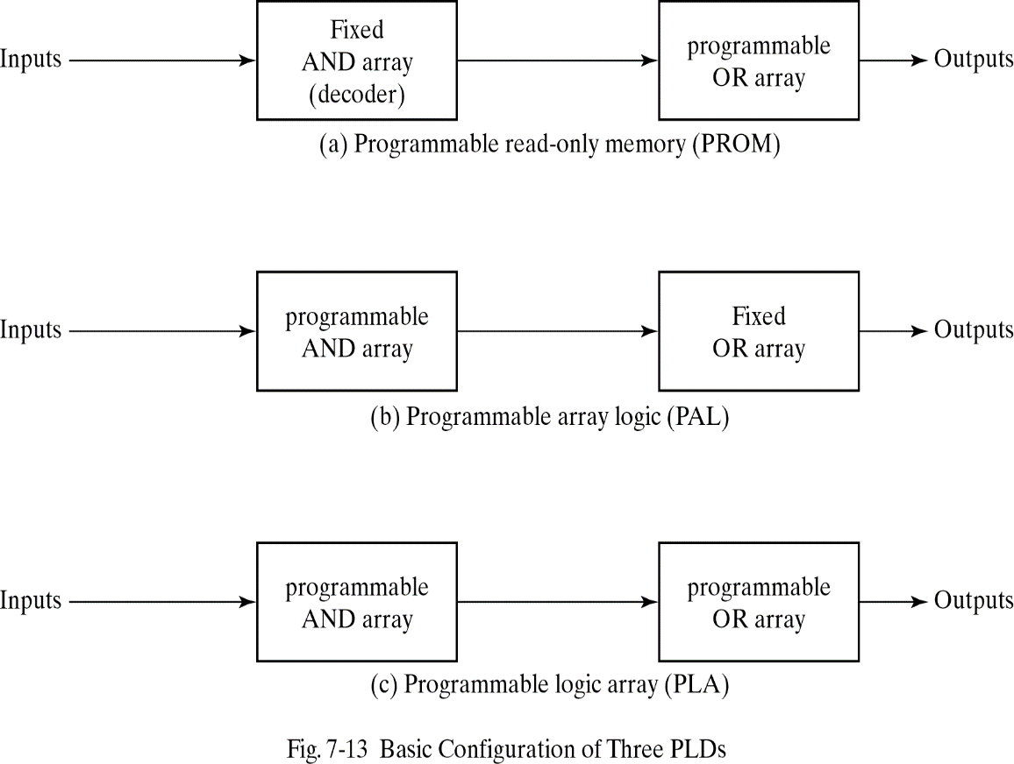
Combinational PLDs
A combinational PLD is an IC with programmable gates divided into an AND array and an OR array to provide an AND-OR sum of product implementation.
Three major types PLDs
(a)fixed AND array +programmable OR array
(b)programmable AND array + fixed OR array
(c )programmable AND array + programmable OR array
26年 11月 8日

Slide 23
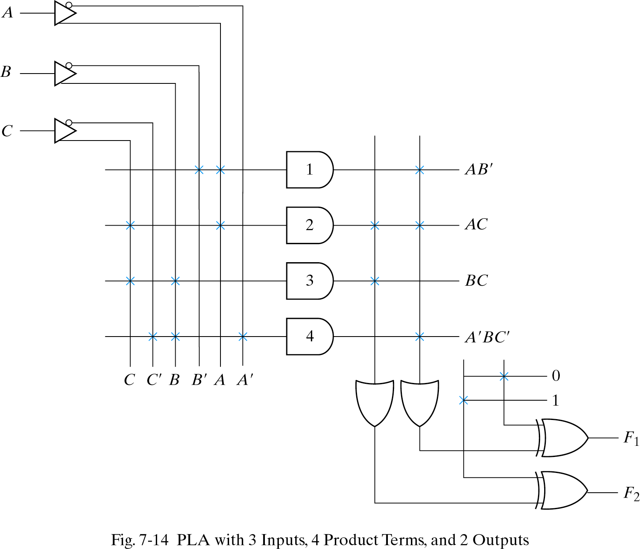
7.6 PROGRAMMABLE LOGIC ARRAY
Programmable OR array
Programmable AND array
26年 11月 8日

Slide 24


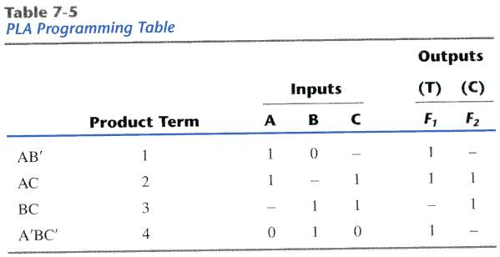
PLA Programming Table
The PLA does not provide full decoding of the variables.(decoder <->AND array)
The PLA consists of n inputs ,m outputs , k product terms(AND gate) ,and m sum terms(OR gate)
The number of programmed fuses is
, whereas that of a ROM is
F1=AB’ + AC + A’BC’
F2= (AC + BC)’
26年 11月 8日

Slide 25
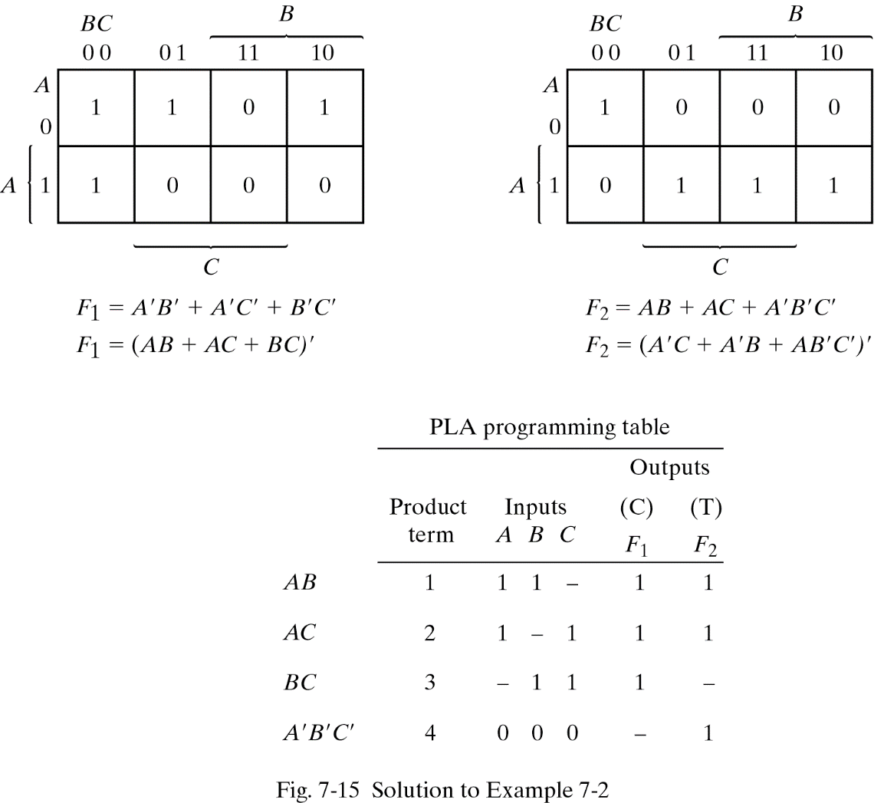
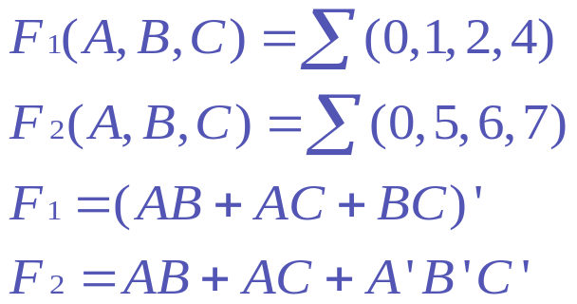
EXAMPLE 7-2
26年 11月 8日

Slide 26
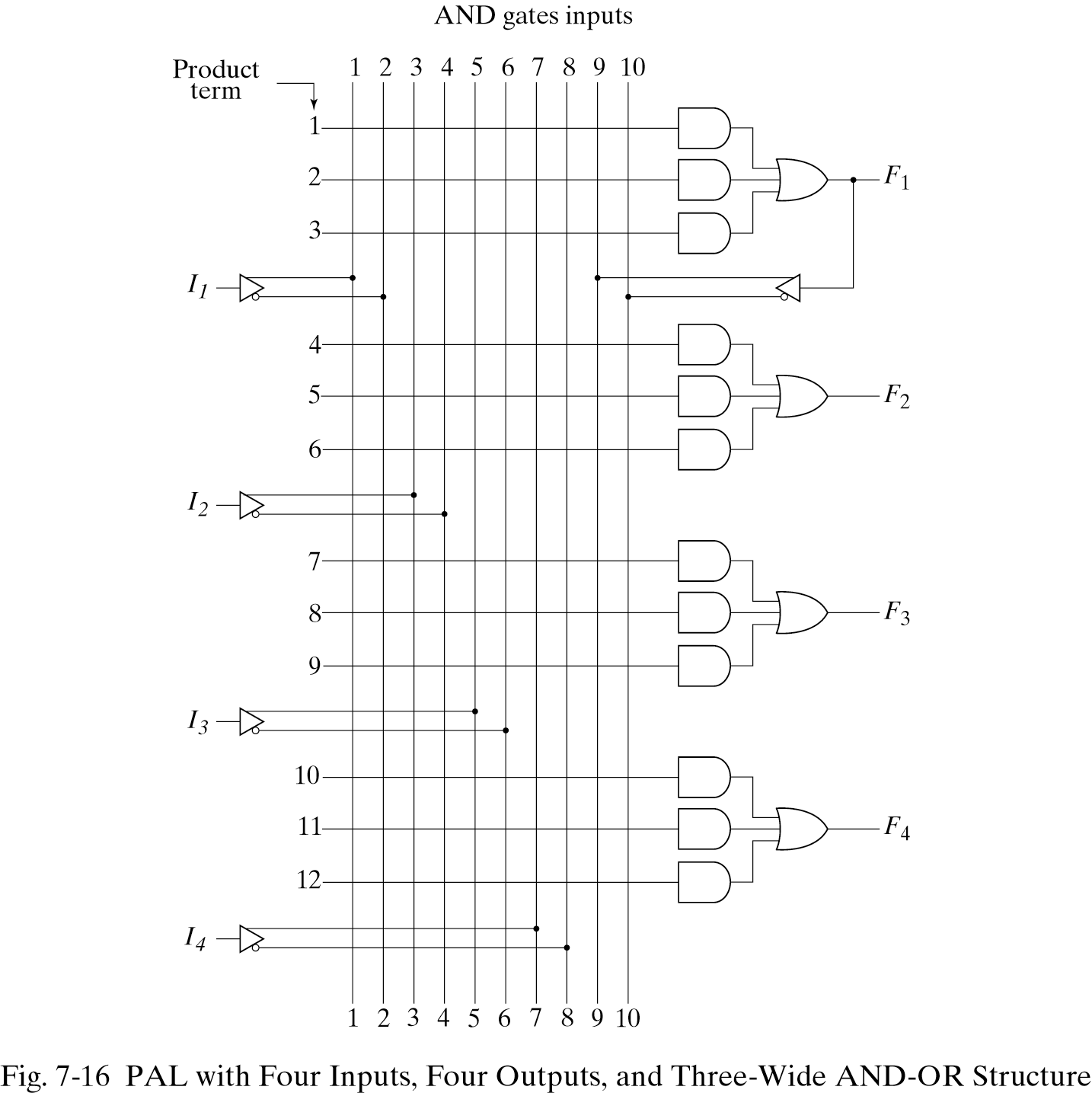
7.7 PROGRAMMABLE ARRAY LOGIC
PAL-With a fixed OR array and a programmable AND array.
-Not as flexible as the PLA(Only the AND gate are programmable.)
26年 11月 8日

Slide 27
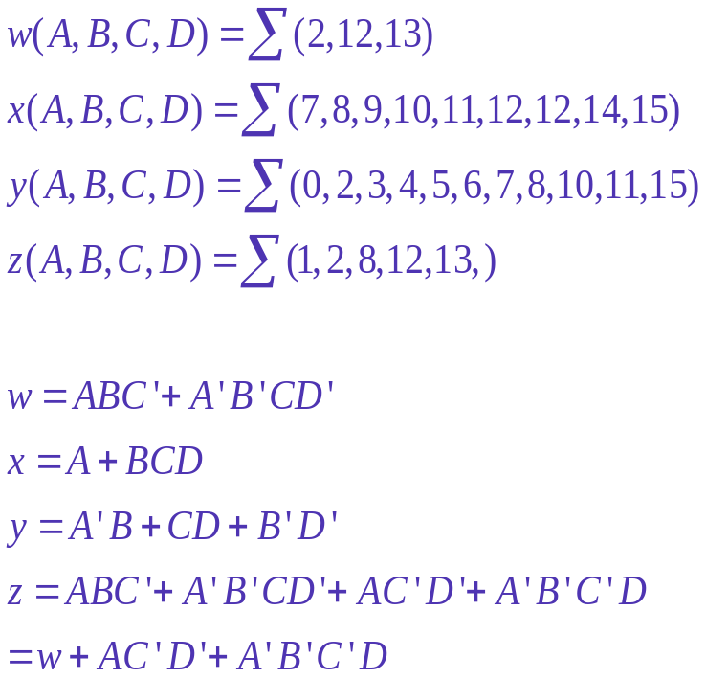
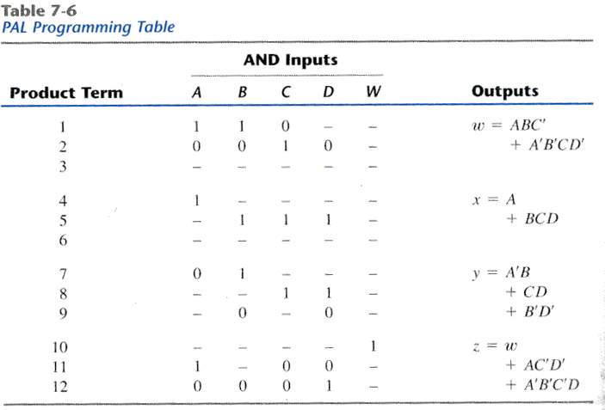
Example(PAL)
26年 11月 8日

Slide 28
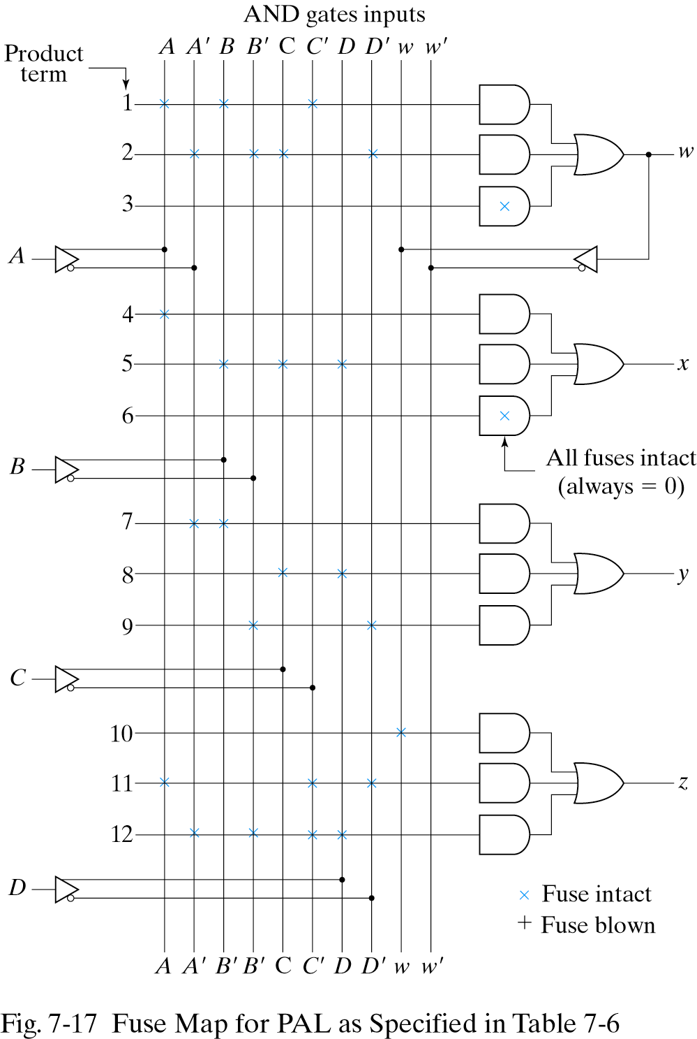
Fuse Map for PAL
26年 11月 8日

Slide 29
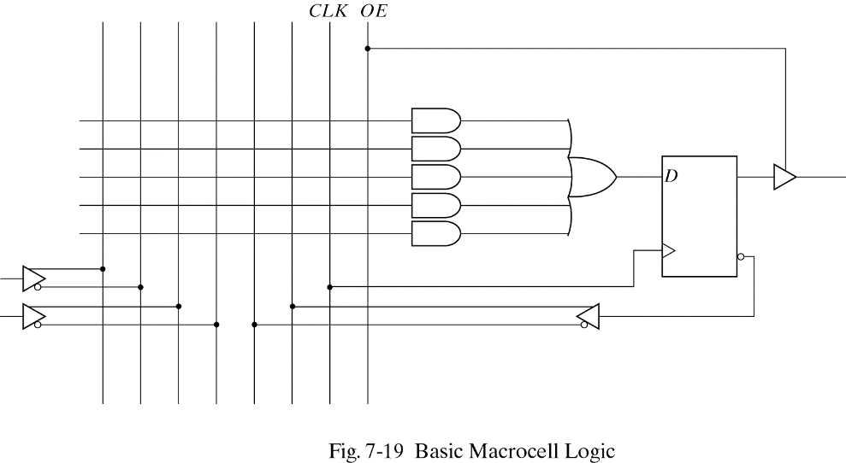
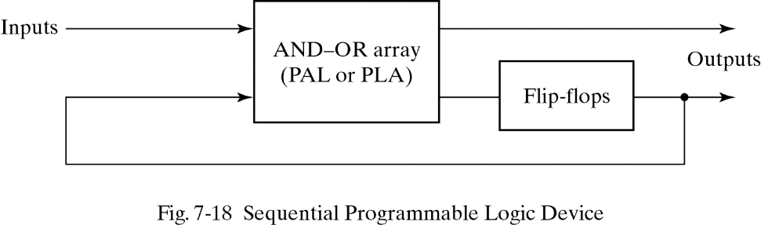
7.8 SEQUENTIAL PROGRAMMABLE DEVICES
Sequential(or simple) Programmable Logic Device (SPLD)
Complex Programmable Logic Device(CPLD)
Field Programmable Gate Array(FPGA)
PAL
26年 11月 8日

Slide 30
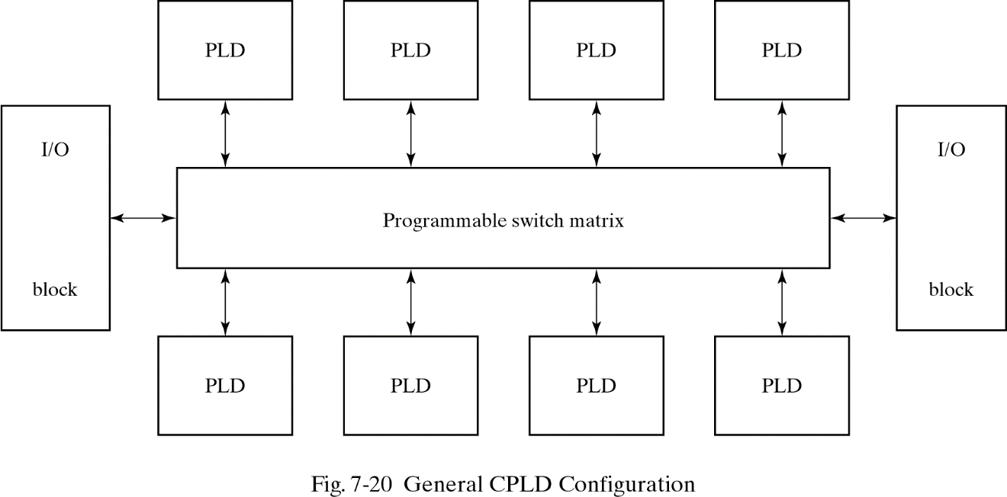
CPLD &FPGA
CPLD-a collection of individual PLDs
FPGA(Field Programmable Gate Array)
-a VLSI circuit that can be programmed in the user’s location.
-look-up tables,multiplexes,gates, and flip-flops
26年 11月 8日

